Slide 1

Smart Jogging Route Recommender
Submitted by,
Ranjith (st)
Sachumon puthenpuraickkal Sajeev (st87014)
Amil Thomas (st87613)

Slide 2
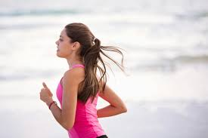
Agenda
Introduction
Project goals and motivations
System Structure and Technology Stack
Data acquisition and processing
Artificial Intelligence and route optimization solution
Visualization, user interface, and health recommendations
Results, Limitations, and Future Improvements
Conclusion and discussion In conclusion,

Slide 3
Introduction
Over the past few years, jogging in urban areas has become more popular. However, when running in urban areas, individuals are exposed to high concentrations of air pollution. Presently, the majority of fitness and navigation apps are only distance or popularity-based without any notion of environmental safety. To address these issues, the new project will introduce the concept of the "Smart Jogging Route Optimization Application," an AI tool that will offer users better and healthier jogging routes. It combines geographic information systems, air quality, and machine learning approaches. This cloud service will enable runners to stay safer by avoiding high levels of dangerous air pollution components like ozone.

Slide 4


Problem Statement
Urban runners are exposed to high air pollution (PM2.5, PM10, Ozone)
Traditional running apps optimize only distance and popularity
Pollution exposure increases respiratory and cardiovascular risks
People with asthma or heart conditions face higher danger
Need for a health-aware, intelligent route planning solution

Slide 5
Quote
Project Objective
Generate safe, healthy, and optimized jogging routes
Minimize pollution exposure using Air Quality Index (AQI)
Consider user fitness level and health conditions
Recommend loop-based jogging paths
Provide an interactive, easy-to-use web application

Slide 6
System Overview
Data-driven AI application
Combines:
Geographic data (GIS)
Environmental data (AQI)
Machine Learning
Graph-based routing
Implemented as a Streamlit web application

Slide 7
Technology Stack
Frontend: Streamlit, CSS
APIs: Google Maps API, Google Air Quality API
GIS & Routing: OSMnx, NetworkX
Machine Learning: Random Forest Regressor (Scikit-learn)
Visualization: Plotly, Plotly Express
Distance Calculation: Geopy

Slide 8
System Architecture
User inputs preferences (location, distance, health)
Location converted to coordinates using Geocoding API
Air quality data fetched in real time
Street network built using OpenStreetMap
ML model scores jogging paths
Best loop routes selected and visualized

Slide 9
Data Preprocessing
Address converted to latitude and longitude
Timezone and elevation information extracted
Real-time AQI retrieved from Google Air Quality API
AQI category and dominant pollutant identified
Data prepared for routing and visualization

Slide 10
Pollution Heatmap Generation
Real AQI used as center reference
Surrounding area modeled using grid-based simulation
AQI values adjusted by distance and randomness
Formula ensures realistic AQI limits
Enables pollution-aware routing decisions

Slide 11
Machine Learning Approach
Model used: Random Forest Regressor
Features:
Path length
Surface type (paved/unpaved)
Target variable:
Heuristic jogging quality score
Output:
Predicted jogging score for each path segment

Slide 12
Route Generation Logic
Walking network created using OSMnx
Only joggable paths selected
Loop routes generated near start location
Routes filtered by:
Target distance (±25%)
Average AQI
Predicted jogging score
Best route selected using multi-criteria evaluation

Slide 13

Visualization & UI
Pollution heatmap (Green → Red AQI scale)
User’s starting point marker
Optimized jogging loop routes
Interactive zoom and selection
Clean, modern UI using Streamlit and CSS

Slide 14
Health-Based Recommendations
Uses AQI + user health conditions
Provides warnings for:
Asthma
Heart conditions
Suggests safer running times or routes
Converts data into actionable health advice

Slide 15
Results & Key Outcomes
Generates safer jogging routes in urban areas
Reduces pollution exposure during exercise
Integrates AI, GIS, and environmental data effectively
Provides real-time visualization and recommendations
Improves user awareness of environmental health risks

Slide 16
Limitations
Pollution heatmap is partially simulated
Limited real-time AQI grid resolution
Jogging score uses limited features
Does not yet consider traffic density or slope

Slide 17
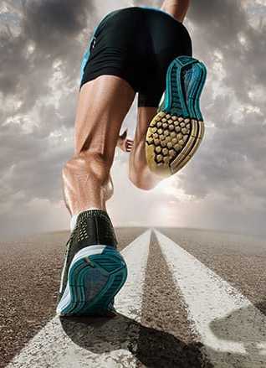

Future Enhancements
Real-time spatio-temporal AQI forecasting
Advanced ML features (traffic, slope, safety ratings)
Cost-based routing using A* or Dijkstra
Personalized learning from user feedback
Mobile application version

Slide 18
Conclusion
Successfully combines AI, ML, GIS, and health data
Goes beyond traditional distance-based routing
Promotes healthier and safer urban running
Strong foundation for a commercial-grade application
Demonstrates practical AI application in real-world health problems

Slide 19


Q & A
We will now open the floor for questions.

